Slide 1
Implementing Pushback: Router-Based Defense Against DDoS Attacks
Salman Raeisi

Slide 2
Outline
Motivation
Introduction
Architecture
Implementation and analysis
Conclusions and future work

Slide 3
Motivational Example
Recently The internet suffered from one of its biggest attacks when multiple devices that make up IoT, were used to take down many high profile sites
Hosting company servers were hit by 1Tbps DDoS attack, which made it the World’s largest DDoS attack launched from ~ 152,000 hacked devices.

Slide 4




Motivational Example
In September 2016, Blizzard games suffered from DDoS attack which impacted players’ ability to launch and maintain stable connections to games like Overwatch and World of Warcraft.
This was the 4th attack affect Battle.net, Blizzard’s game client, in the couple of weeks.

Slide 5
Introduction
A distributed denial-of-service (DDoS) attack, an attacker that may use computer to attack another computer, by taking advantage of security weaknesses, an attacker could take control of compromised computer.
He or she could then force compromised computer to send huge amounts of data to a website or send spam to particular email addresses.
The attack is "distributed" because the attacker is using multiple computers, to launch the denial-of-service attack.

Slide 6









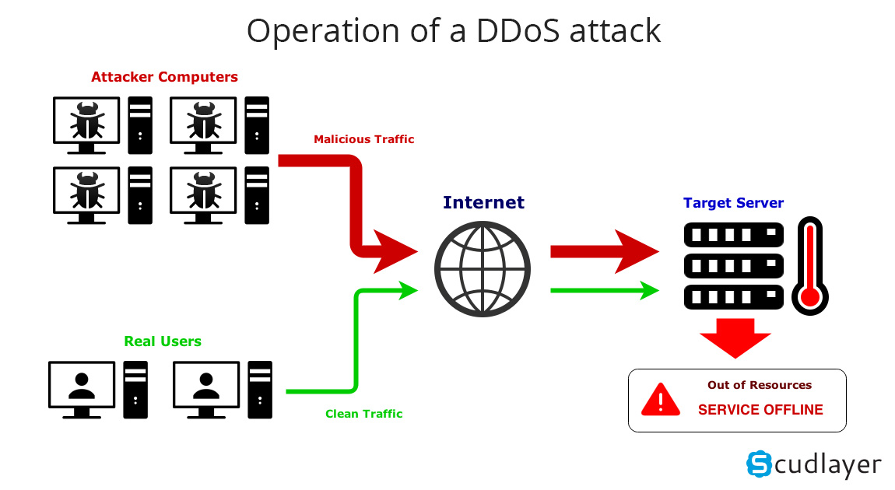



Introduction

Slide 7
Introduction
What is a bad and good Packet?!
ACC - aggregated-based congestion control.
Drop congestion responsible aggregates.
Pushback
Illustrate by Example

Slide 8
Architecture
Bad packets sent by the attacker.
Poor traffic have congestion signature.
Good traffic.

Slide 9
Architecture
R1
R2
R3
R4
Bad packet: UDP packets to D
R5
R6
R7
Poor packet: UDP to D ( not part of the attack)
Good packet TCP to D
R8
D

Slide 10
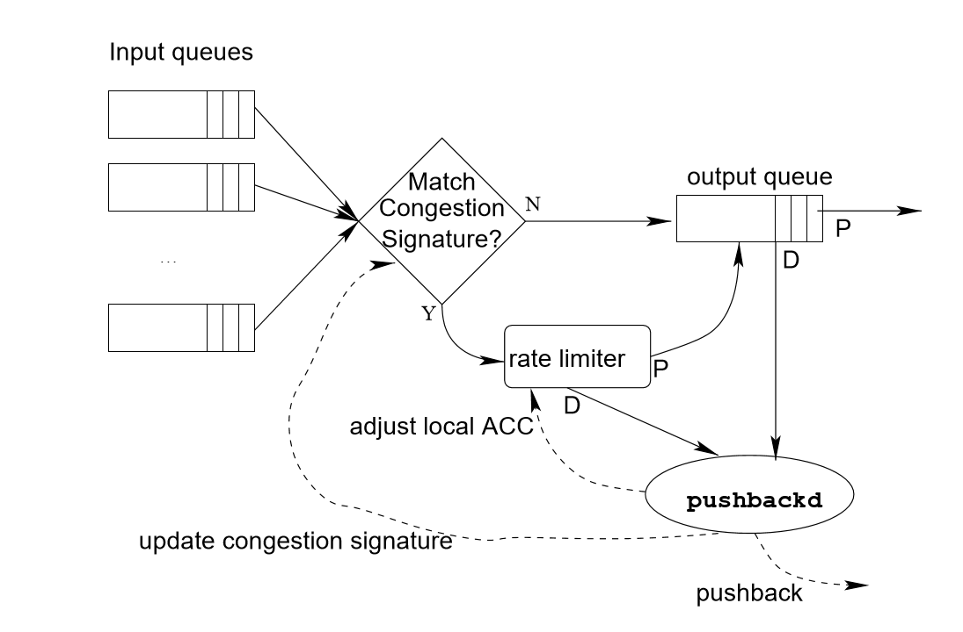
Architecture
Router Inner Pushback Design

Slide 11
Architecture
Aggregate Detection
Based on the Destination IP address.
Congestion level is high
Match the IP with routing table.
Get longest prefix.
Dropped packet Destination IP | Routing Table
10.1.1.1 | 10.1.0.0
10.1.1.2 | 10.10.0.0
10.1.1.1 | 10.20.30.0
10.1.1.1
10.10.09.1
10.1.1.3
10.10.20.01
10.20.30.10
10.1.1.4
Longet Prefix
10.1.0.0
10.10.0.0

Slide 12
Architecture
Continue Aggregate Detection
Sort the drop set based on prefix.
Longet Prefix | Dropped packet Destination IP
10.1.0.0 | 10.1.1.1
10.1.0.0 | 10.1.1.2
10.1.0.0 | 10.1.1.1
10.1.0.0 | 10.1.1.1
10.1.0.0 | 10.1.1.3
10.1.0.0 | 10.1.1.4
10.10.0.0 | 10.10.09.1
10.10.0.0 | 10.10.20.01
10.20.30.0 | 10.20.30.10

Slide 13
Architecture
Continue Aggregate Detection
Find the most frequent prefix
.
Longet Prefix | Dropped packet Destination IP
10.1.0.0 | 10.1.1.1
10.1.0.0 | 10.1.1.2
10.1.0.0 | 10.1.1.1
10.1.0.0 | 10.1.1.1
10.1.0.0 | 10.1.1.3
10.1.0.0 | 10.1.1.4
10.10.0.0 | 10.10.09.1
10.10.0.0 | 10.10.20.01
10.20.30.0 | 10.20.30.10
Longet Prefix
10.1.0.0

Slide 14
Architecture
Continue Aggregate Detection
Find longer prefix within the drop set
congestion signature
Longet Prefix | Dropped packet Destination IP
10.1.0.0 | 10.1.1.1
10.1.0.0 | 10.1.1.2
10.1.0.0 | 10.1.1.1
10.1.0.0 | 10.1.1.1
10.1.0.0 | 10.1.1.3
10.1.0.0 | 10.1.1.4
Longet Prefix
10.1.1.0

Slide 15
Architecture
Continue Aggregate Detection
Repeat if the congestion level is still high
No prefix found = General Traffic
Rate-limit and queue manage the congestion.

Slide 16
Architecture
Rate limit
Rate-limit to a threshold
Rate-limit to eliminate all congestion signature traffic.
Attack is on rate limit continue to drop packets.
Attack is stop the rate-limit will stop.

Slide 17
Architecture
Pushback
Once a prefix is defined
Send the information to the upstream link.
Uses TTL to authenticate.
Cancel messages to stop rate-limit in the upstream routers.
Status messages is sent downstream.

Slide 18
Implementation and analysis
Implemented under FreeBSD.
Used IPFW as rate-limiter
Modified the kernel to sent the information of queue dropped packet to the pushback daemon.
Keep sample of the drop packet.
Run the aggregate-detection algorithm periodically.

Slide 19
Implementation and analysis
Measurements indicated that good traffic got through
Further fine-tune
Sampling rate
Detection interval
Consider feedback information

Slide 20
Conclusions and future work
DDoS is real problem.
Pushback is promising for combating DDoS attack.
Use Cisco Committed access rate as rate-limiter.
Examine traffic on both incoming and outgoing links to detect congestion and dropped packets.

